Slide 1
UPC
Unified Parallel C
Adam Karl

Slide 2

UPC History
Developed at Berkeley in 1999
Attempt to combine best features of:
AC
Split C
Parallel C Preprocessor (PCP)
Berkeley implementation constantly updated
Specifications last updated 2013
Compiler updated 16 April 2021
Extend C to add:
An explicitly parallel execution model
A shared address space
Synchronization primitives and a memory consistency model
Parallel utility libraries

Slide 3
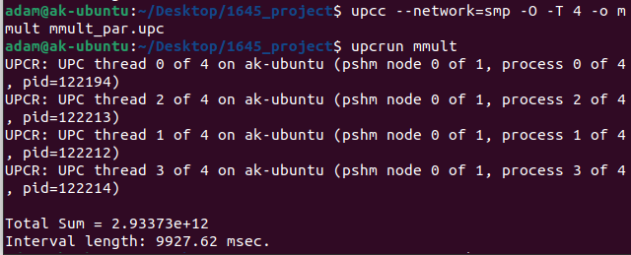
Setting up Workflow
Installation
Compile + Run
download the tarball from https://upc.lbl.gov/download/
$ ./configure --disable-NETWORK_API
$ gmake
Not particularly reliable
$ gmake tests-hello
$ sudo gmake install
Add bin to path
Default /usr/local/berkeley_upc/bin
$ upcc --network=smp -T 4 -o hello hello_world.upc
Set number of threads with –T flag
$ upcrun hello

Slide 4
UPC Execution Model
Partitioned Global Address Space Language
All threads run the entire program independently
Number of threads can be specified either at compile-time or run-time
Available as variable THREADS
MYTHREAD specifies thread index, from 0 to THREADS-1

Slide 5
Hello world
#include <upc.h>
int main(int argc, char const *argv[]) {
printf("hello from thread %d of %d\n", MYTHREAD, THREADS);
return 0;
}
Each thread prints its thread index

Slide 6
“shared” variables and Affinity
shared
Affinity
Simply put “shared” in front of any variable declaration for all threads to have access to it
shared int Weight[NROW][NCOL];
Otherwise, the variable will be private to the specific thread
Each shared variable only has one physical location
By default, primitive types will physically be located in thread 0
Threads 1+ will have a pointer to a location in thread 0
Non-primitive types (e.g. arrays) are instead spread evenly across all threads

Slide 7
Miscellaneous
Shared memory management
upc_global_alloc(), upc_free()
Called by 1 thread, all have access
upc_all_alloc(),
Called by all functions, but they all point to the same space in memory
#include <upc.h>
#include <upc_strict.h>
#include <upc_relaxed.h>
Synchronization
upc_barrier;
upc_notify & upc_wait
Locks
upc_lock() & upc_unlock()
*upc_global_lock_alloc(void);
1 lock, pointer to 1 thread
*upc_all_lock_alloc(void);
1 lock, pointer to all threads

Slide 8
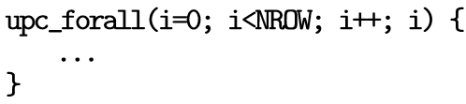
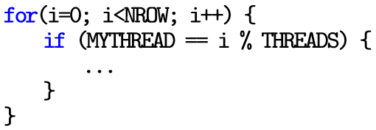
upc_forall
Like a normal for loop, except the 4th input decides how to split the work among the threads
Can also use the location of a variable to increase efficiency
& outputArrayC[i][0]

Slide 9
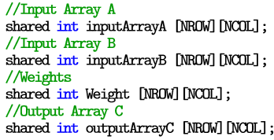
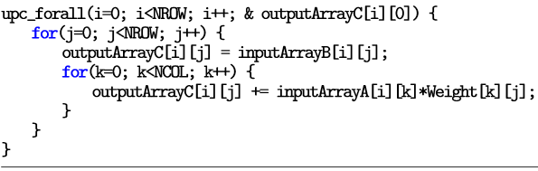
First Attempt at Matrix Multiplication
Shared all matrices
Used upc_forall to divide work evenly among threads
…did it work?

Slide 10
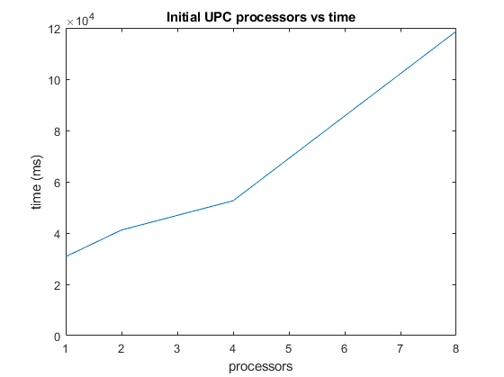
…the runtime actually increased

Slide 11
What was Happening?
The Problem
The Solution
Keep in mind each element in the matrix only exists once
Since the matrices are evenly distributed across
With 4 processors, there’s a 75% chance inputArrayA[i][j] is located at a different processor
All those fetches are slow…
Blocking
UPC allows you to guide how arrays/matrices are distributed

Slide 12
Types of Blocking
cyclic (per element)
Default style of blocking
shared int x [NCOL]
1 element each, wrapped
x[0] at thread 0
x[1] at thread 1
x[2] at thread 2
…
Blocked-cyclic (user-defined)
user-defined size blocks and the blocks are cyclically distributed among threads
shared [10] int x [NCOL]
10 elements each, wrapped
x[0]-x[9] at thread 0
x[10]-x[19] at thread 1
X[20]-x[29] at thread 2
…
Run-time: shared [1000/THREADS] int x [1000]

Slide 13
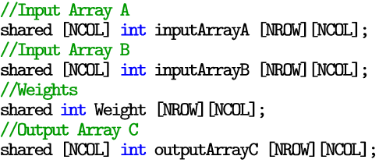
Updating Matrix Multiplication

Slide 14
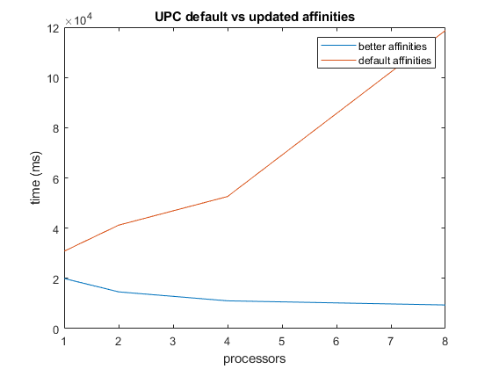
Massive improvement

Slide 15
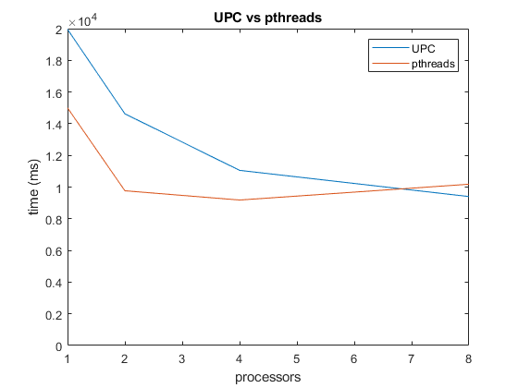
Compared to pthreads

Slide 16
UPC Breakdown
Pros
Cons
Quick and easy to implement
upc_forall is extremely elegant
Quality of life
Built for network computing
Scales very well
Lots of room for fiddling/optimizing
Compatible with a LOT of libraries
Difficult to install
Not many tutorials online
Running on single machine seems like a waste
Slow, especially for small data
Takes knowledge of blocking to see any improvement
Distributed memory only works for some algorithms

